Slide 1
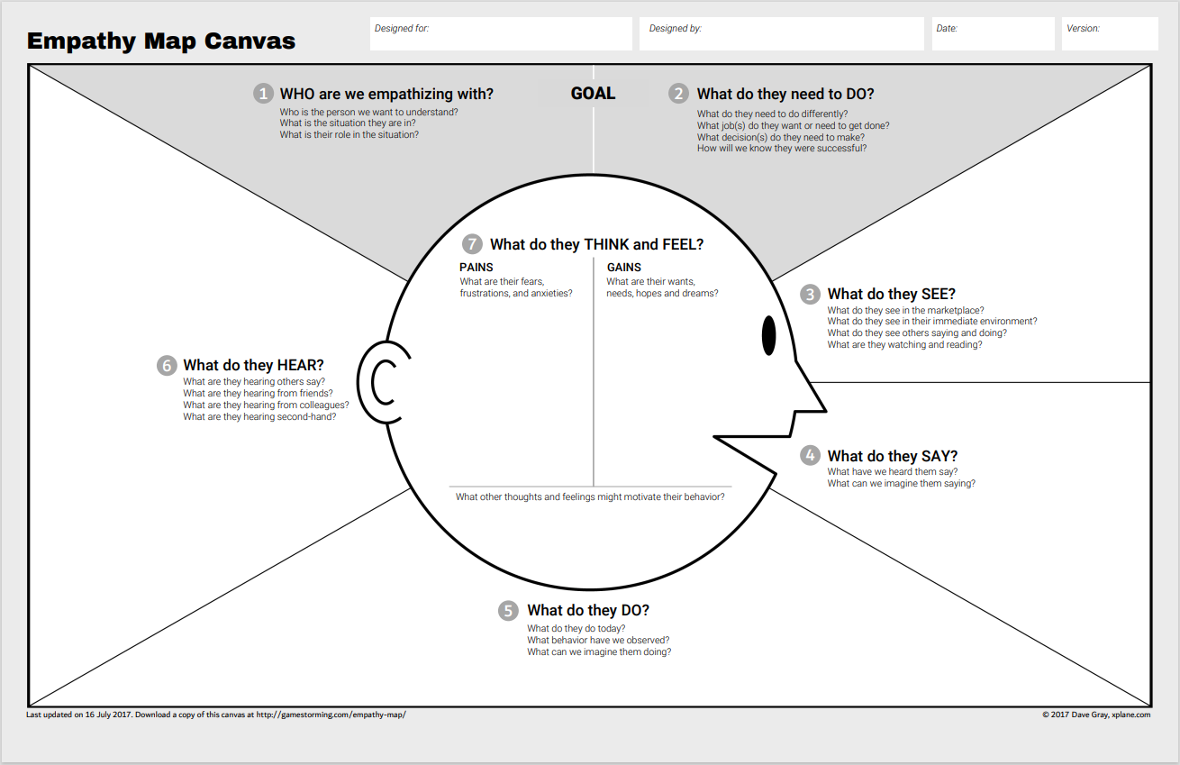
Onboarding New Employee
The Plattwurf Team
Wants to make a good first impression
New employee
A lot of questions how to do things
Wants to do a good job
A lot of touchpoints and sources
Are we ready for the new employee start date?
A lot of trainings
IT system not working
How can I develop my skills?
Where do I find help?
When will I get my feedback from new boss?
Where do I start?
Thanks for your help
Can it be less administrative?
Batch does not worl
How far are we in the process?
When will I meet my team?
Takes time to find the HR IT support
Learning moduls solved
Sending mails for questions
Open IT tickets to solve problems
Searching through the intranet to get answers

